Slide 1
2020 CORPORATE GENEROSTY RESEARCH REPORT
March 2020
Note: We invite you to use these images for your business communications.
Please credit goBeyondProfit for the insights.
Contextual details are provided in the downloadable PDF and Press Release available on goBeyondProfit.org.
goBeyondProfit is a statewide alliance launched by business leaders for business leaders to spur corporate generosity and improve people’s lives.

Slide 2
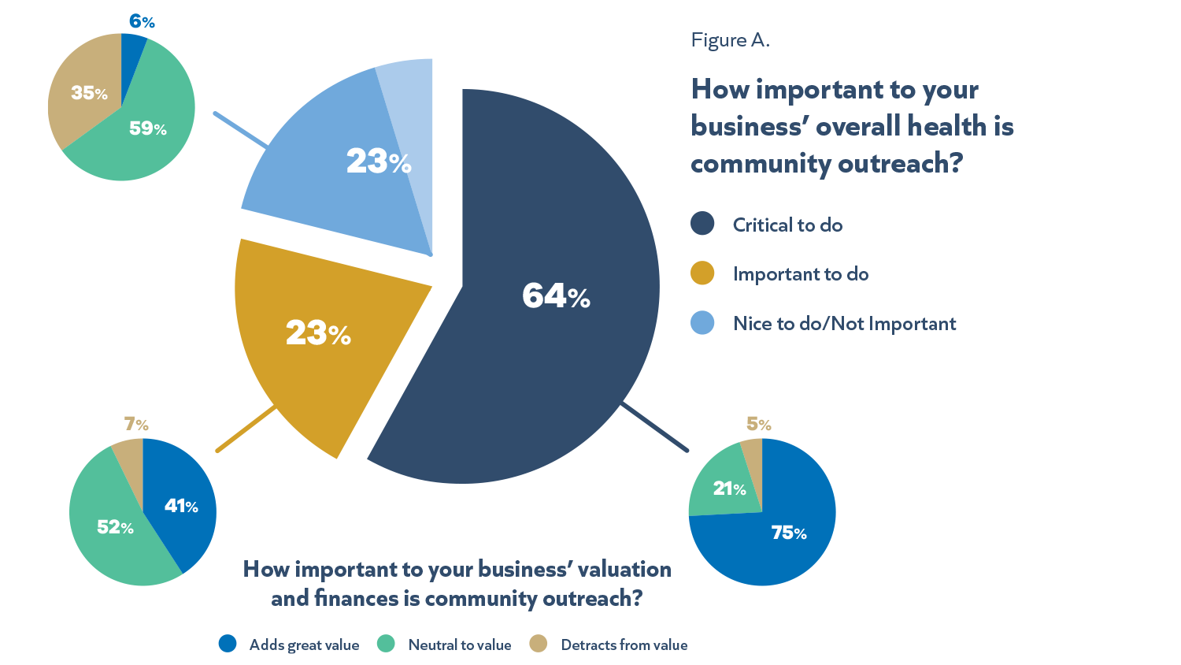
Senior Leaders See Business Value in
Corporate Generosity

Slide 3
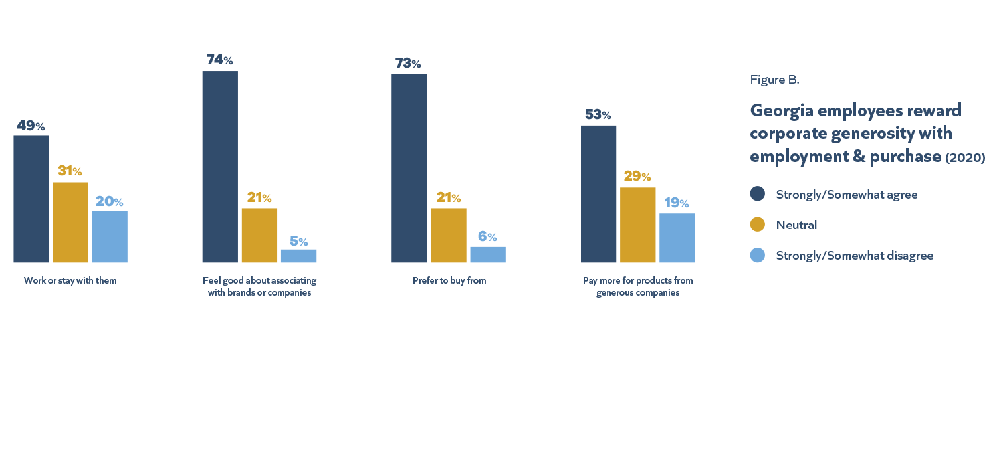
Employees & Consumers Reward Generosity

Slide 4
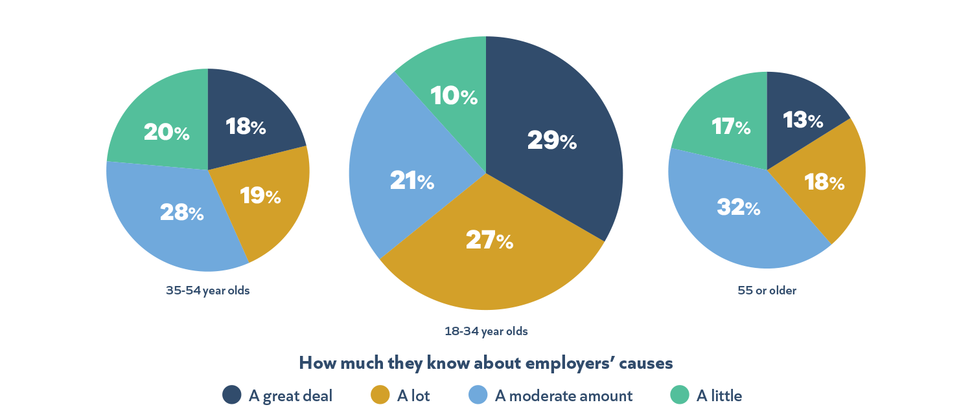
Younger Employees Know More about Employees’ Causes …

Slide 5
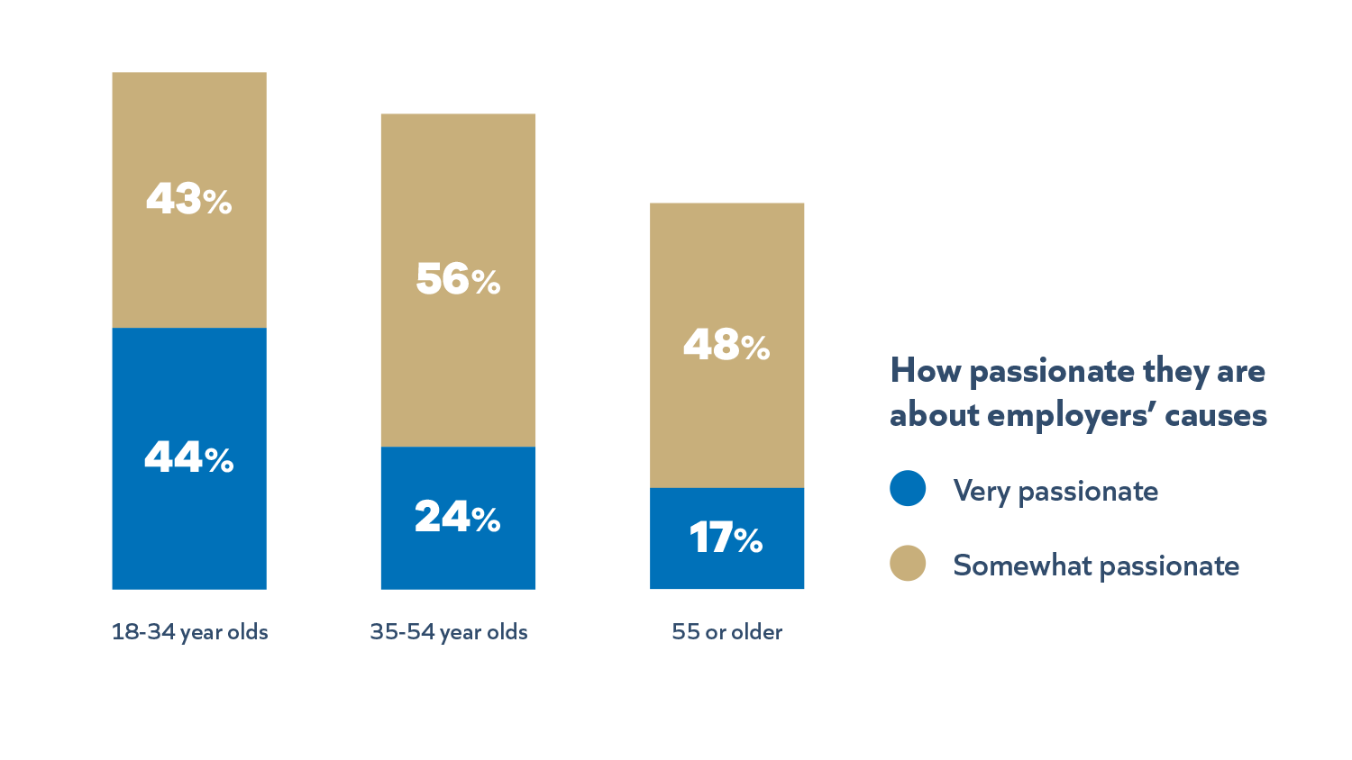
… and Younger Employees are More Passionate

Slide 6
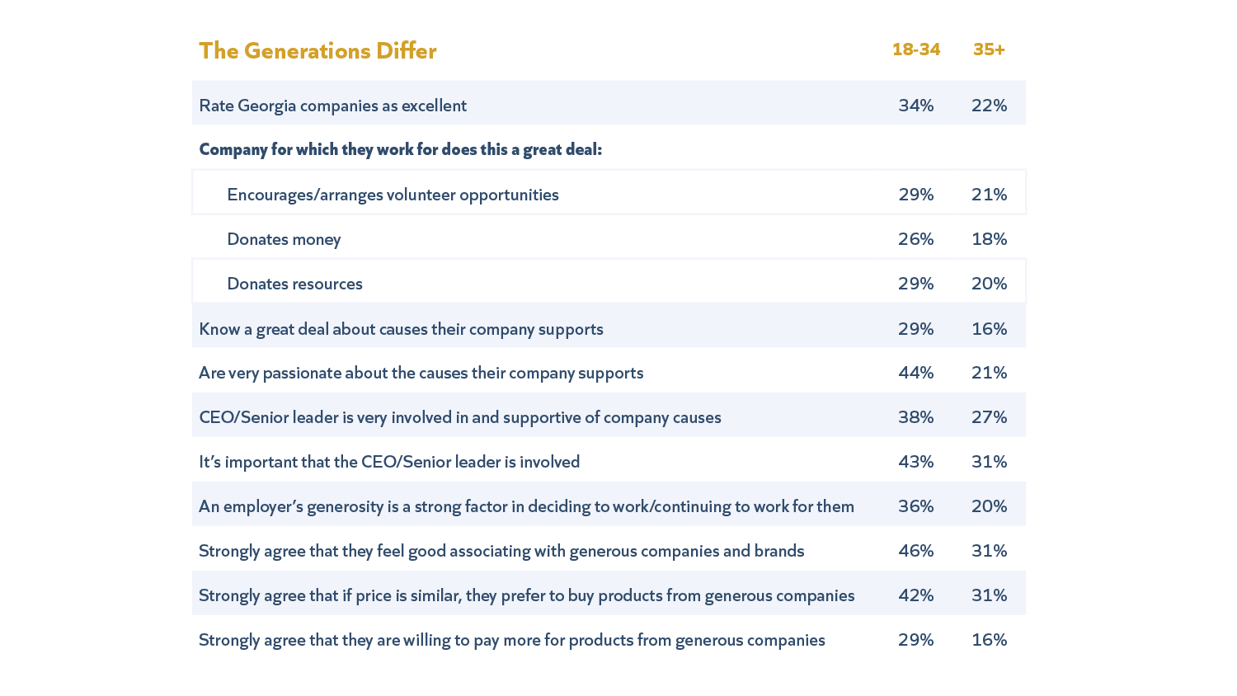
Employees 34 and Under Demonstrate Greater Engagement

Slide 7
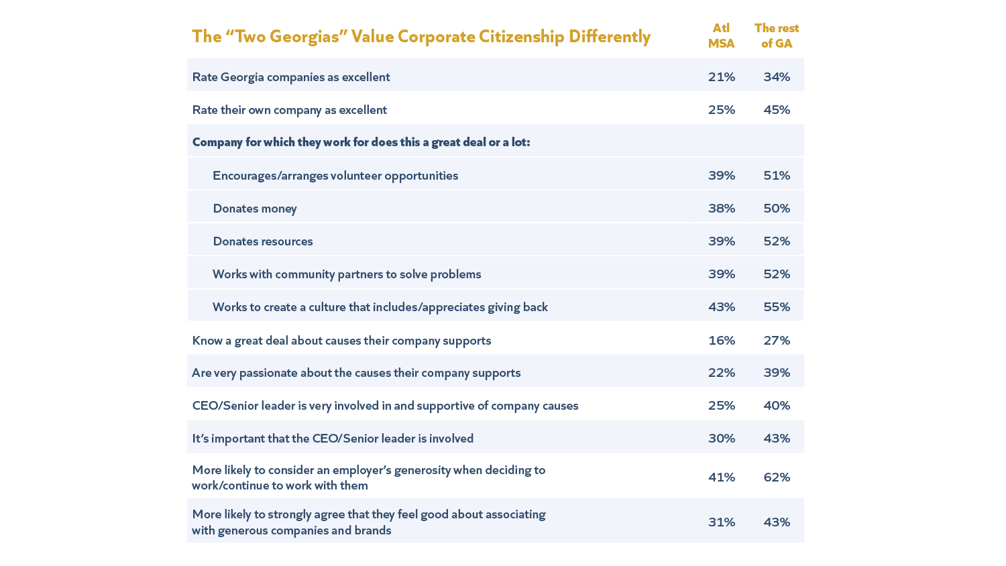
Georgians Outside Atlanta Care and Engage More

Slide 8
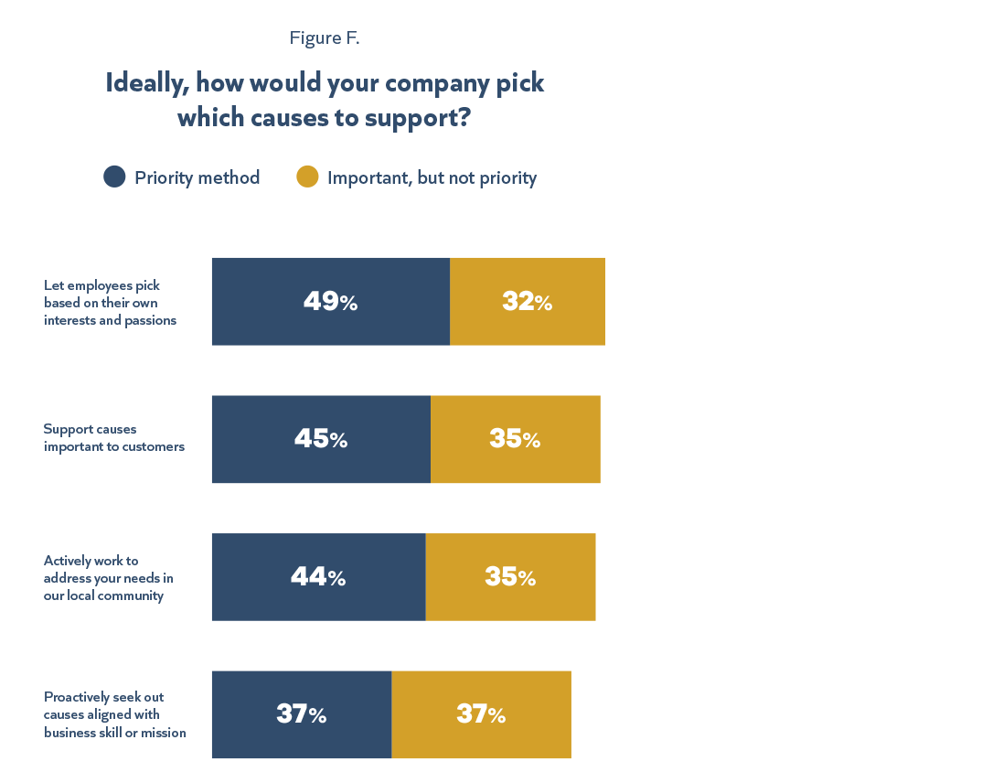
Georgians Want Business Choices to Reflect their Hierarchy of Personal Interests

Slide 9
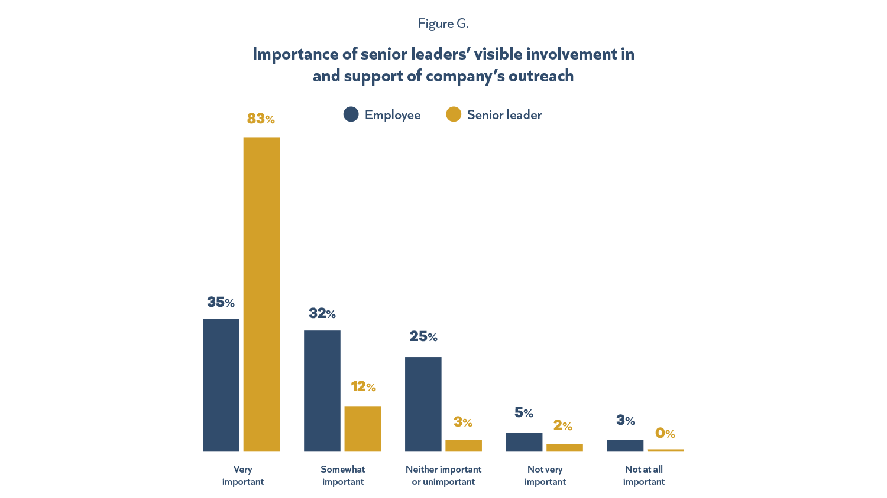
Execs and Employees Value Leaders’ Visible Involvement

Slide 10
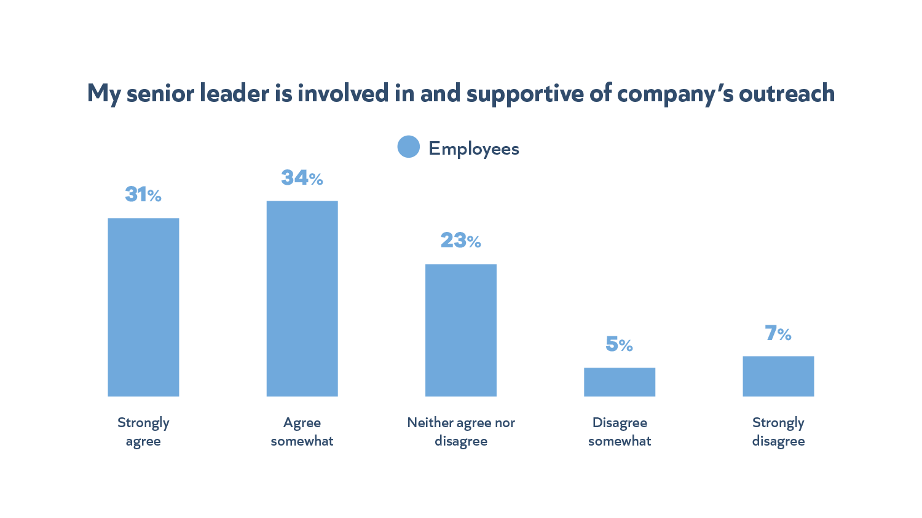
Many Employees Don’t See Their
Leader’s Involvement

Slide 11
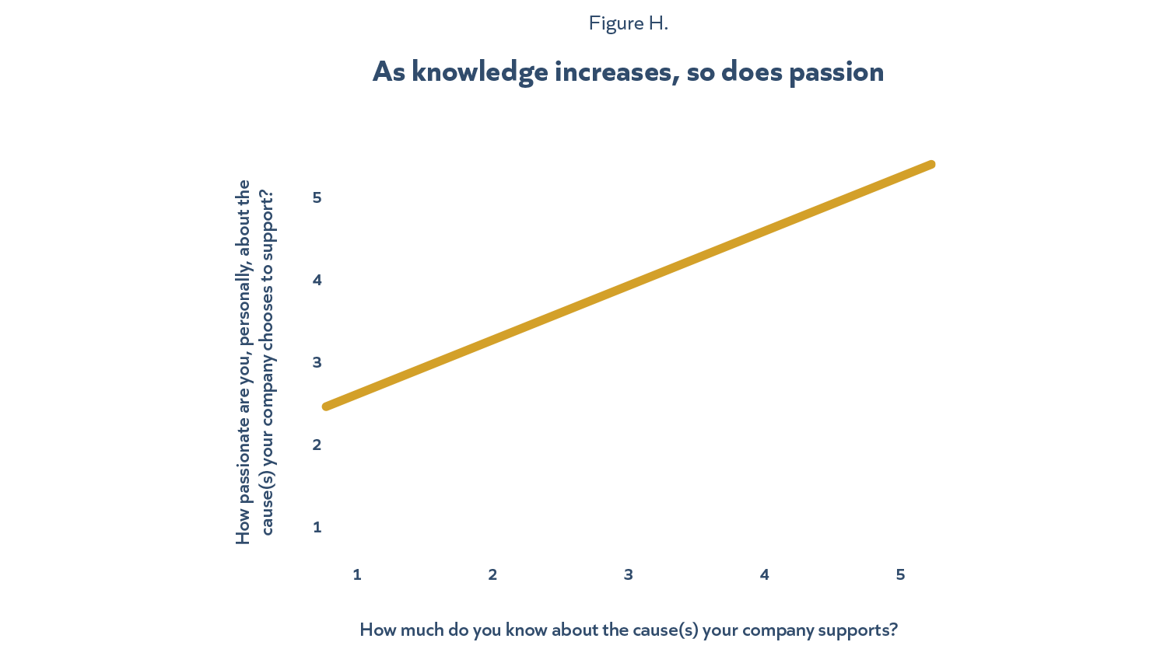
Knowledge About Causes Correlates
with Passion

Slide 12
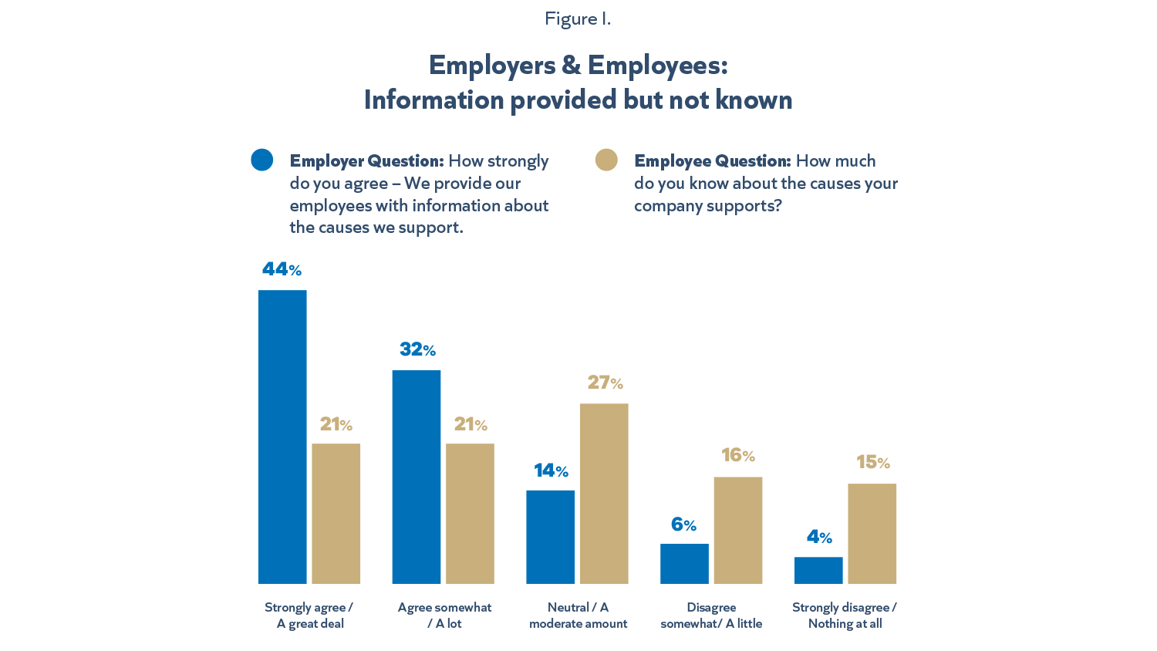
Despite Leaders’ Communication Efforts, Many Employees
Don’t Know About
Company Causes

Slide 13
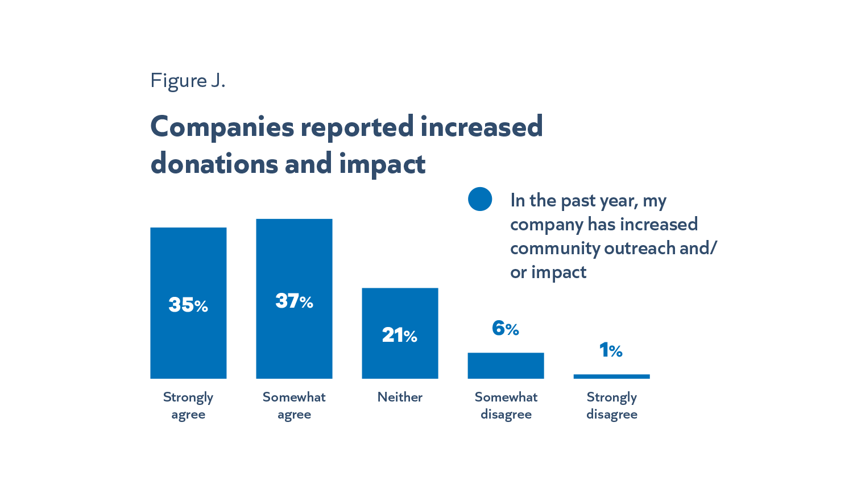
2020 Donations & Impact Reportedly Up Over 2019

Slide 14
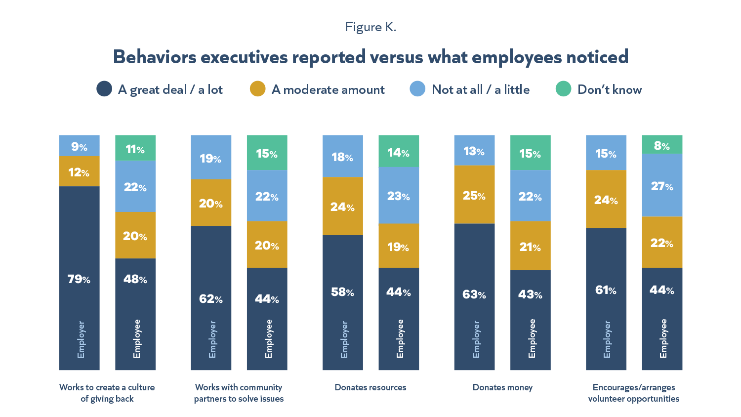
Employees Don’t See All Their
Employers’ Outreach

Slide 15
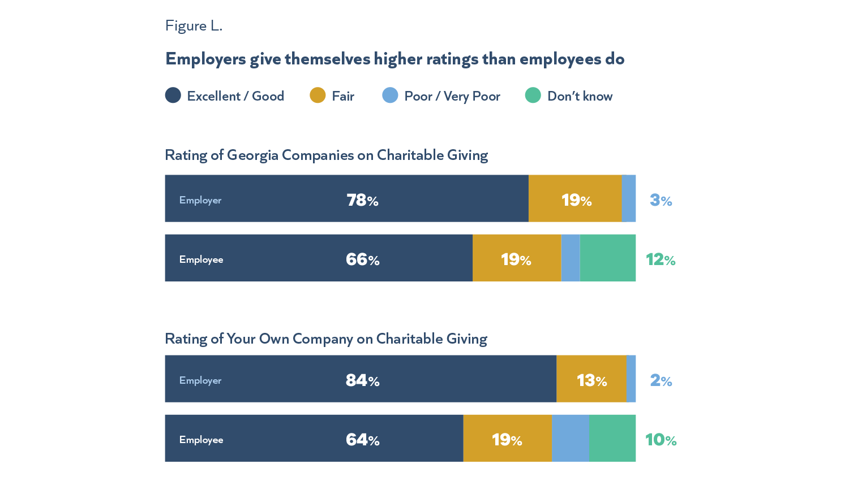
Gap Between How Highly Executives and Employees Rate Georgia Businesses

Slide 16
Methodology
Two separate surveys were simultaneously conducted by goBeyondProfit during the first quarter of 2020.
Georgia senior executives qualified for the survey if they were in a senior leadership position with a company that has a Georgia presence. The Georgia Chamber and Georgia CEO, a network of local websites focused on the state’s business communities obtained respondents for this survey via email invitations to their databases. The survey was open from February 4 – February 24, 2020 and drew 244 completes. At a 95 percent confidence level, this survey has an error range of +/- 4.3%.
An online survey was conducted among 500 Georgians between February 5-February 10, 2020. GoBeyondProfit contracted with Dynata, a provider of first-party data, contributed by people who opt-in to participate in surveys and market research, for the sample. Respondents qualified for the survey if they were 18 years of age or older and were employed by a company that has a Georgia presence or a Georgia office. The survey drew 523 completes. At a 95% confidence level, this survey has an error range of +/- 6.3%.

